Slide 1
The Paleo Diet
Real Food Nutrition for Real life

Slide 2
Welcome & Introduction
Welcome!
My background & Paleo Journey to date

Slide 3
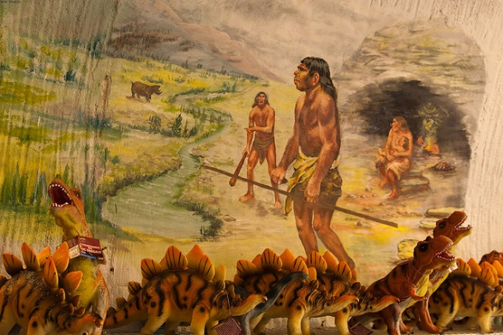
What IS The Paleo Diet?
Where did all begin?
The Paleo Diet is the original diet. It is based on the diets of our ancestors and consists of real, unprocessed foods which would have been native to a given area.
The Paleolithic era spanned from earliest estimated use of stone tools to the onset of the industrial revolution (approximately 10,000 years ago)
There is no ONE Paleo diet. Diets varied from area to area depending on what was available seasonally and locally.
It is the diet we are genetically suited to eating – real, unprocessed food.

Slide 4
Examples of Different Paleo Diets
HIWI : Savannah people of Venezuela and Columbia – Climate consisted of large shifts ranging from drought to heavy flooding resulting in a diverse eco-system.
Diet consists of water birds, wild game such as deer, gathered roots, lizards, turtles and fruit.
75% animal intake, 25% plant based
Sami Diet: Northern Norway, Sweden, Finland, Russia – Sub artic and artic climates with mixed areas of forest and treeless terrain.
Primarily hunters and fishers with some plant nutrition. Diet included reindeer (major component) salmon, bear, walrus, moose, rabbits and berries

Slide 5
Examples of Different Paleo Diets
Inuit Tribe: The Artic, Greenland, Canada, Alaska – Land very inhospitable to much agriculture so focused on large fatty marine animals.
Seal, walrus, fish, shellfish, seaweed, lichen, berries, roots.
96% of food was from animal origins with plants making up the rest
Hadza Tribe: North Central Tanzania
Nose to tail meat consumption of birds and mammals, tubers, and berries
48% animal food, 52% plant based

Slide 6
INTERESTING SIMILARITIES
Reliance on hunted game, regardless of climate. Meat was key to survival.
While there was emphasis on plant based nutrition the further you got to the equator, there are instances where plant based nutrition played a very small part
There were no vegetarian tribes – meat played a large part in overall diet
No refined grains
No refined sugars
No processed foods
Importance of nose to tail eating – not just the lean meat

Slide 7
Where did it all go wrong?
Prior to the industrial revolution (approximately 10,000 years ago) homosapien’s diets were made up of real unprocessed foods.
Industrial processes such as animal husbandry and grain processing occurred too quickly for human evolutionary processes to catch up.
Sudden changes in diet associated with the Neolithic era emerged along with:
Sudden increase in glycaemic load (how foods effect our blood sugar levels)
Changes in fatty acid composition of foods (too high of Omega 6 fatty acids)
Macronutrient composition changes etc
“The evolutionary collision of our ancient genome with the nutritional qualities of recently introduced foods may underlie many of the chronic diseases of Western civilization1”.

Slide 8
Onset Of Modern Disease
The modern diet has a lot to answer for! Large quantities of grains, processed food, sugar and dairy have led to us being the sickest we have EVER been.
Modern disease such as cardiovascular disease, diabetes, obesity, oesteoporosis and cancer can all be attributed to lifestyle and environmental factors and increased INFLAMMATION.
Genetics play a small part, but something in our environment is triggering these processes2.
We can’t control everything around us, but we can control what we voluntarily put in our bodies.
We can control our FOOD.

Slide 9
The Modern Paleo Diet
While it is true that there is no way to exactly replicate the original diet, that is not what is important!
What we aim for in a modern Paleo diet is to provide our bodies with a healthful, unprocessed diet focusing on quality proteins, healthy fats and “good carbohydrates”.
Removing all the toxic and inflammatory foods from the modern diet and eating a clean diet based on real foods.
Including healthful foods such as bone broths and sauerkraut which are very important for gut health. Important to off set the effects of eating gluten which causes “leaky gut”

Slide 10
Paleo Diet VS Modern diet

Slide 11
Foods Permitted
Quality protein such as wild oily fish, beef, lamb, turkey, chicken, eggs, nuts and seeds.
Healthy fats such as oily fish, avocados, olive oil, coconut oil, nuts and seeds, coconut milk, eggs.
Colourful Vegetables such as kale, cabbage, broccoli, peppers, beetroot, butternut squash
Starchy tubers such as sweet potato, parsnip and white potato (limited)

Slide 12
Exempt Foods
All processed foods such as processed meats, crisps, biscuits boxed foods.
Grains such wheat, rye, spelt, rice
Processed carbohydrates including breads, pastas, pizza, muffins, cereals (including oats) and crackers
Gluten free products such as breads are not permitted as they are still very refined and processed.
Sugars except raw honey and maple syrup in moderation
Dairy including milk, cheese, yoghurts
Processed refined vegetable oils such as Crisp n Dry or margarine
Alcohol (except wine in moderation)

Slide 13
Why popular nutrition advice is flawed
For years we have been taught incorrect information.
Dairy is NOT healthy and necessary for bone health
Red meat does NOT cause cancer
Saturated fat does NOT cause heart disease
Cholesterol does NOT cause heart disease
Whole-grains are NOT healthy foods and are NOT necessary for a healthy diet
Notes:
Dairy – mucus forming – many who suffer sinus/congestion issues are big milk drinkers. Links with hormonal cancers. IGF linked to cancer
Red meat – can be proinflammatory if BAD QUALITY, eating quality organic, grassfed meat from a reliable source is a good way to limit this. Also the effects of removing other inflammatory foods such as grains limits the effects of this. Studies were conducted on those eating a SAD and lots of meat.
Saturated fats – this has recently been challenged. There is no evidence to suggest there is a link between saturated fat and heart disease. Inflammation causes heart disease.
Cholesterol – does not cause inflammation. It is merely present at the site of inflammation but not the cause. Fireman analogy

Slide 14
Health Benefits of Paleo Eating
Improved energy levels due to more sustained blood sugar levels.
Decreased glycaemic load which leads to better insulin management, reduced body fat % and improved blood panels.
Removal of common allergens such as wheat, dairy and soy.
Improvement of digestive discomfort such a bloating, flatulence and reflux
Better sleep quality
More balanced hormones due to the removal of sugars – leading to improved blood sugar levels, reduced irritability, more stable moods and less PMS symptoms for the ladies
Reduced inflammation = reduced risk of chronic diseases

Slide 15
Tips for weight loss
Choose a smaller plate – the meal looks bigger!
Chew slowly – it gives your brain time to register that you are full and allows proper digestion to take place
Eat plenty of vegetables from a rainbow of colours
Protein with every meal and snack – this helps to stabilise blood sugar levels and limit the release of insulin and fat storage
Limit fruit consumption to 2 pieces per day and choose less sweet option such as apples and berries
Increase fat consumption. You need to Eat Fat To Lose Fat!

Slide 16
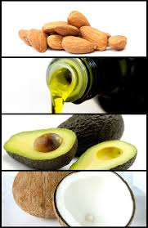
Eat fat to lose fat
Our aim is to move into a more efficient mode of burning fat for energy. This is not only the dietary fat you are hopefully eating plenty of but STORED fat that you want to shift. It is more economical to use fat because it lasts longer and keeps us satisfied longer.
4 calories in a gram of carbohydrate, 9 calories in fat but it LASTS longer. Less effect on glycaemic index
Paper & Log analogy
You must replace the refined carbohydrates with fat – this is why many people struggle with paleo – find it difficult to eat enough calories as they don’t eat enough fat.

Slide 17
Paleo & the Triathlete
Why is the Paleo Diet so beneficial to the Tri-Athlete?
Focuses on quality protein which is important for repairing muscle following exercise
Anti-inflammatory which reduces the onset of injury and helps repair muscles faster
Better long term recovery from training and races due to higher micronutrient intake
Higher fat intakes provide the body with greater energy and satiety
Improves performance by improved muscle recovery and energy
One area people often fall down on is eating enough FAT. Many claim they have less energy as a result of lower carb intake but the important aim of Paleo eating for athletes is to allow your body to utilise FAT for energy thus saving glycogen stores and preventing fatigue.

Slide 18
Limitations of Paleo for the Triathlete
It is fair to say that the basic Paleo framework does have some limitations for the endurance athlete.
Our early ancestors would not have ran for fun or exercise like we do today.
While they would have ran after prey during a hunt, it would have been short lived, and would certainly be followed up by many days of rest afterwards.
The basic Paleo diet is probably lacking in sufficient carbohydrates for the endurance athlete and we must therefore incorporate some changes around training and race day nutrition.

Slide 19
Paleo & the Triathlete
Key to Paleo Success for the Triathlete
Keep most of the meals within the basic Paleo template
Make adjustments before, during and after training to reap the benefits.
BEFORE training
Aim to eat 2 hours before training – aim for 400 – 600 calories
The further you are from your training session, the lower the GI of the food you want to eat. Eg. 2 hours before slow release, low GL food such as sweet potato would be ideal. If you are eating an hour before, white potato might be a better option.
10 minutes before you start – have a quick acting sugar like a banana or a gel. This will give you a boost in energy without the dip in energy associated with eating high sugar food too early. This is because you use this energy immediately- no surge in insulin.

Slide 20
Examples of Good Pre Workout Meals
• Fruit and eggs – eggs are easily digestible protein. Boiled eggs can be easily transported to a race venue. A whole contains 6g protein and 1.5g of BCAA. Combine with fresh fruit especially low fibre fruits like banana, peach, melon. Avoid fibrous fruits such as apple, berries, grapes or pineapple as they may cause upset stomach
• Chicken and ½ avocado with banana
• Smoothie with protein powder for easily portable meal

Slide 21
Eating During the Event
Eating During Events (90 + Minutes)
The longer the event, the more important it is to refuel. From the outset replace some of the expended glycogen to delay the onset of fatigue. Do not wait until near the end to take on carbohydrate. It is best to take it on in liquid form during exercise so make your own “sports drink”
The use of gels is generally accepted at this level as food carbohydrates will not be absorbed quickly enough.
Eventually your body will train itself to become more efficient at burning fats for energy. This can take up to 6-8 weeks.

Slide 22
Make your own sports drink
1 litre of such as green tea, herbal teas, coconut water or plain water.
⅛-1/4 tsp Sea Salt
¼ cup or more of juice not from concentrate – apple, orange, grape etc (better yet make your own!)
1-2 TBSP honey.
Brew tea if using or slightly warm base liquid
Add sea salt
Add juice and mix or shake well
Cool and store in fridge until ready to use

Slide 23
Post exercise (30 minute window)
Your body is 3 times more efficient at replenishing glycogen levels at this point than at any other.
During a training session or race your glycogen stores have been greatly diminished and muscle damage has taken place.
So important to get nutrition correct here to ensure adequate recovery and preparation for the next race.
Replenish expended carbohydrate stores – you should focus on more dense carb sources here such as sweet potato, parsnips etc. I would focus on complex version unless you will be doing more endurance exercise in the next 48 hours. In that case I would use more fast acting carbs like white potatoes.

Slide 24
Post Exercise - AIMS
Rehydrate – Replenish fluid levels by taking in 500ml of liquid for every pound lost during exercise. This will take longer than 30 minutes but start now. Let thirst dictate.
Provide amino acids for repair of proteins damaged during exercise – Protein particularly BCAAs (leucine, isoleucine and valine) should be taken in at a carb to ratio of 4:1 over 30 minute period. Base your snack around protein source and vegetables and fruit.
Electrolyte Balance – Important to replenish electrolytes such as potassium, sodium, chloride, calcium and magnesium. Coconut water can be helpful here
Reduce acidity – Body fluids move towards a more acid during exercise. This can lead to loss of calcium and nitrogen from bones and muscle. Fruits and vegetables have an alkalising effect on the body – choose fruits and vegetables such as raisins, bananas, spinach etc

Slide 25
Make your own recovery drink
Pineapple (cup of chunks)
Berries (Handful)
Protein powder (Quality, scoop)
Coconut Water (cup)
Pinch of sea salt
Ice (if desired)
Blend

Slide 26
Long term recovery stage
The longer the workout, the longer this stage
If the workout was 2 hours for example, factor in the 30 minute recovery window and then allow another 1.5 hours for this stage.
Focus on the guidelines above but base it around a balanced meal.
Example of long term workout meal:
Salmon with sweet potato and green salad with raisins
Good fats (reduce inflammation, good protein source), low GL carbs and raisins and salad to replace glycogen stores and balance pH (acidity levels)

Slide 27
Post recovery stage
Switch back to standard Paleo framework of nutrition:
Protein, carbs and fats and moving away from reliance on high starch vegetables.

Slide 28
Supplements for the endurance athlete
Joints can suffer as a result of endurance sports. It is important you support your joints by eating plenty of oily fish (salmon, mackerel, sardines, herring) – 2/3 times a week.
Consider a good quality omega 3 oil for reducing inflammation in joints.
Vitamins and minerals important too to reduce free radicle damage created during exercise – increase fruit and vegetable intake – a colourful rainbow
Sometimes we need a helping hand: Consider a joint support supplement like GLC2000 which:
Recover from injury - Fast
Improve Your Joint Mobility
Strengthen Connective Tissue
Rebuild & Nourish Cartilage

Slide 29
How To Incorporate paleo into your Diet
Keep meals simple – focus on protein (chicken, beef, lamb, fish) + carbs (vegetables, starchy vegetables like sweet potatoes and white potatoes) + fats (coconut oil, olive oil, avocados, eggs, nuts and seeds)
Take it one meal at a time – it can be daunting at first. Breaking it down into manageable chunks of the day makes it easier
Prepare, prepare, prepare! Preparation really is key. You risk being caught off guard and eating something that is not on plan if you do not prepare.
Get breakfast ready the night before to save time in the morning – try omelettes, smoothies or leftovers
Lunchbox it! Take leftovers to work in your lunchbox or alternatively take a good quality flask to work with soup or stew in it.

Slide 30
How To Incorporate paleo into your Diet
Cook family friendly versions of foods which are easy to make Paleo such as bolognaise, stews, soups and curries. This cuts down on cooking by ensuring everyone eats the same food
Make plenty of food at dinner and eat the leftovers the next day. This cuts down on cooking time.
Only buy healthy foods – if it not in the cupboard you cant be tempted.
Forget “breakfast foods” – any food can eaten for this meal! Rename it Meal 1 if it makes it easier on you!

Slide 31
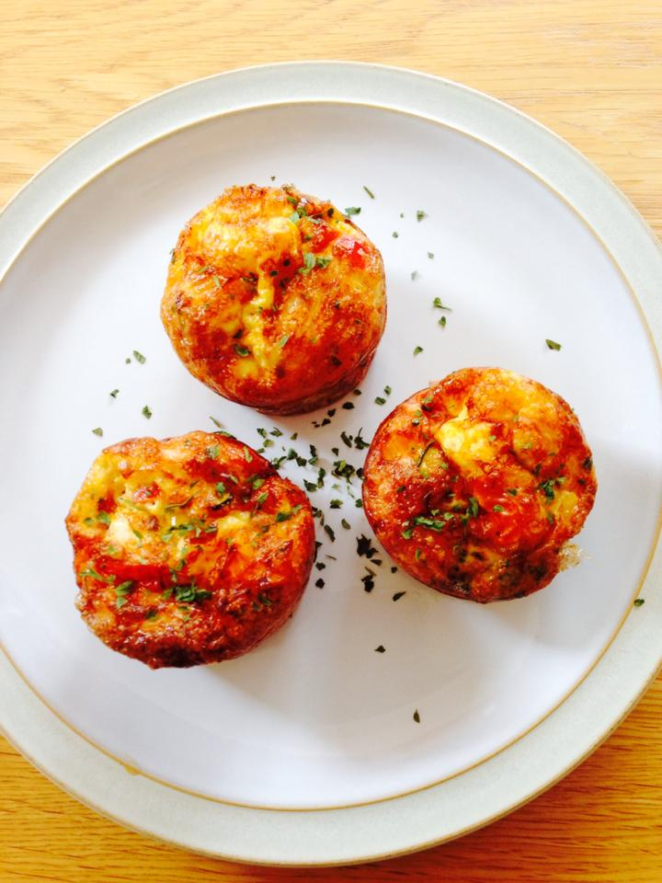
Meal suggestions
Breakfast
Avocado Smoothie
Scrambled egg & organic bacon
Omelette with various vegetables
Mini “quiches” with rocket and tomato salad
Leftover steak, onion and sautéed spinach

Slide 32
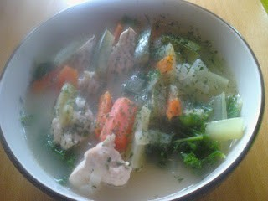
Meal Suggestions
Lunch
Hearty Chicken & Veg Soup
Steamed salmon with green salad and avocado
Leftover beef burgers and green beans
Tinned mackerel and salad

Slide 33
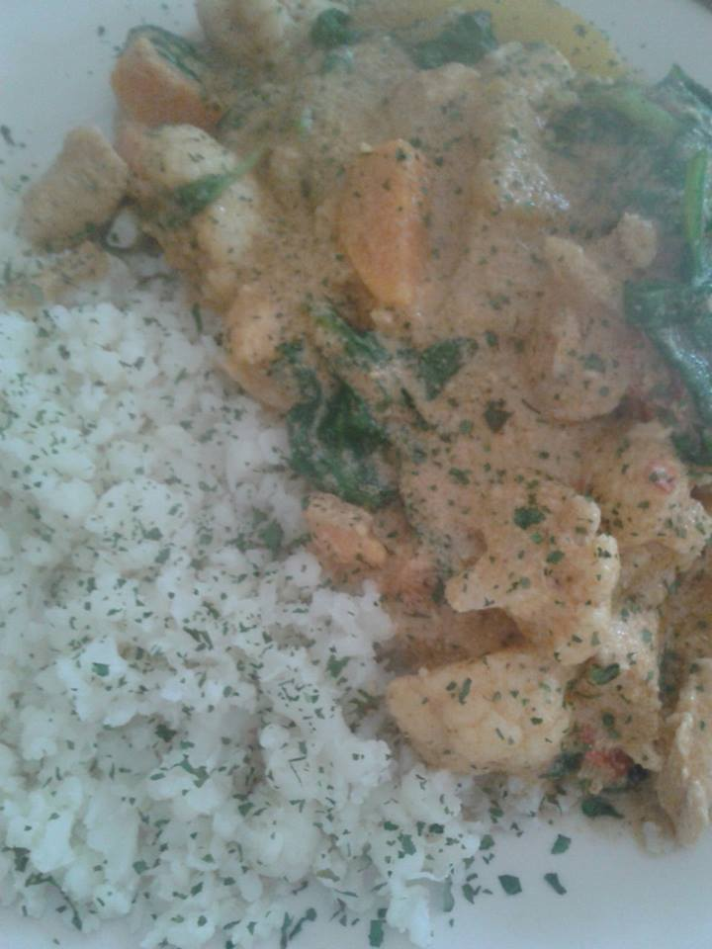
Meal Suggestions
Dinner
Coconut Chicken & Sweet Potato Curry
Rib eye steak with roast sweet potato and broccoli
Beef casserole with cauliflower mash
Lamb Meatballs and courgette “pasta”

Slide 34
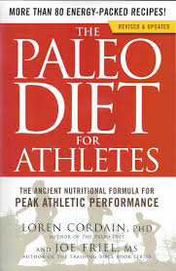
Reading
If you are interested in the Paleo approach to nutrition I recommend reading The Paleo Diet for Athletes by Loren Cordain and Joe Friel

Slide 35
Questions?

